Slide 1


Literature Review on Wearable/Mountable Robots for Positioning US Scanners
RAYAN HASSAN
UNIVERSITY OF PITTSBURGH
SUMMER UNDERGRADUATE RESEARCH PROGRAM (SRUP)
CUHK SUPERVISOR: PROF. HONGLIANG REN
DEPARTMENT OF ELECTRONIC ENGINEERING

Slide 2
Content
Overview on Ultrasound (US) Principles
Sound waves propagation
Sound waves interactions with tissues
Image resolution
Transducers
Robotic Systems for US Scanning
Mountable robots
Wearable robots
Soft robotics
Applications of Robots in US
Human assisted systems
Autonomous systems
Localization of Targeted Areas for US
Review on convolutional neural networks (CNN)
AI algorithms for US procedures

Slide 3
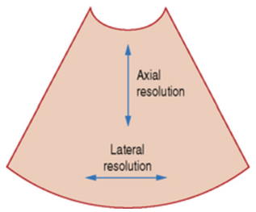
Overview on Ultrasound Principles
Sound waves propagation
Propagation: quick in dense material; slow in compressible material
In soft tissues velocity of waves is constant
Sound waves interactions with tissues
Reflection upon hitting a surface with different density
The larger the difference the more echoes are reflected back
Refraction: percentage of waves get through the surface tissue
Other interactions include attenuation, interference, etc.
Image resolution
Axial, lateral, spatial and temporal resolution
Transducers
Operates by changing piezoelectric crystal’s shape in response to an electric field
Wave sent with a centre frequency
Wave decomposed into harmonic frequencies after hitting tissues
Fig.1 Difference between axial and lateral resolution shown in a US image

Slide 4
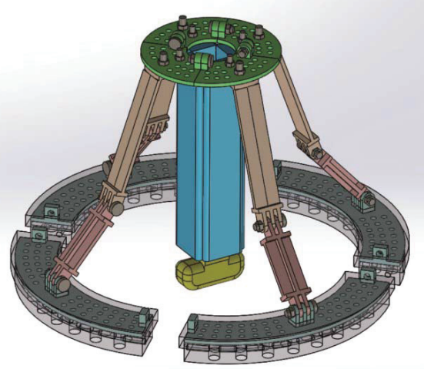
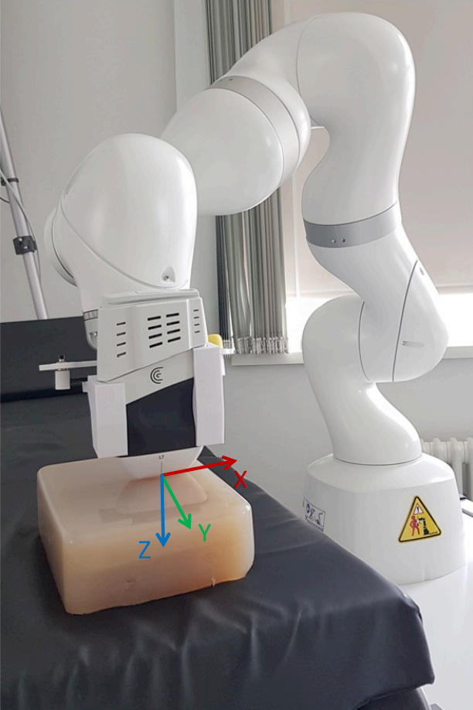
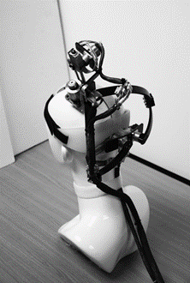
Robotic Systems for US Scanning
Mountable robots
Handle probe and position in optimal way
Generation of 3D images
Wearable robots
No risk caused by patient’s movement
Brain simulation
Fig.2 KUKA LBR Med robotic arm Fig.3 Prototype of wearable robot for
transcranial US applications
Soft robotics
Robots made out of soft materials
Allow flexibility and compliance
Fig.4 Attachable soft robot
Origami devices: made out of flat composite sheets
Limitless options for robotic designs

Slide 5
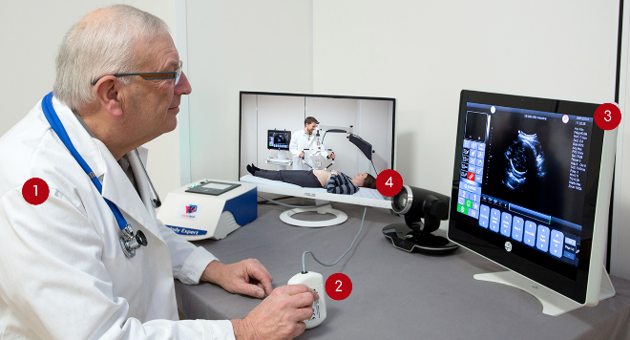
Applications of Robots in US
Human assisted systems
Teleoperation: operation of machine remotely
System consists of robot that handles the probe (patient’s side) and screen with remote probe (doctor’s side)
Fig.5 MELODY robotic system: example of remote US scanning
Autonomous systems
Reduce human intervention
Three main notions: 3D image reconstruction, trajectory planning and probe positioning, and image quality optimization

Slide 6
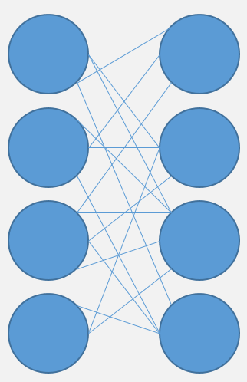
Localization of Targeted Areas for US
S
O
F
T
M
A
X
Review on CNN
Convolution
ReLU
Pooling layer
1 Convolutional Layer
AI algorithms for US procedures
Accurate localization of area of interest
Helps predict the right area to scan
Helps with other applications like drug delivery or tumour/infection detection
Fully Connected Layer

Slide 7
References
Fig.1: Resolution. Radiology Key. (2016, March 10). Retrieved August 13, 2022, from https://radiologykey.com/resolution/
Fig.2: Unger, Michael, Berger, Johann, Gerold, Bjoern and Melzer, Andreas. "Robot-assisted Ultrasound-guided Tracking of Anatomical Structures for the Application of Focused Ultrasound" Current Directions in Biomedical Engineering, vol. 6, no. 3, 2020, pp. 123-126. https://doi.org/10.1515/cdbme-2020-3032
Fig.3: Kim, Joonwoo & Lee, Sungon. (2016). Development of a Wearable Robotic Positioning System for Noninvasive Transcranial Focused Ultrasound Stimulation. IEEE/ASME Transactions on Mechatronics. 21. 1-1. 10.1109/TMECH.2016.2580500.
Fig.4: H. Ren, X. Gu and K. L. Tan, "Human-compliant body-attached soft robots towards automatic cooperative ultrasound imaging," 2016 IEEE 20th International Conference on Computer Supported Cooperative Work in Design (CSCWD), 2016, pp. 653-658, doi: 10.1109/CSCWD.2016.7566066.
Fig.5: Melody, a remote, robotic ultrasound solution. AdEchoTech. (n.d.). Retrieved August 13, 2022, from https://www.adechotech.com/products/

